Slide 1

Opening a traditional dining restaurant in New Orleans by exploring different neighborhoods
IBM Professional Data Science Capstone
By Sara Rauf

Slide 2
Introduction
New Orleans is the most populous city in Louisiana with a population of an estimated 390,144. It is world-renowned for food, music, festivals, and celebrations. Food is one of the main attractions in this historically and culturally rich city.
In 2005, New Orleans was majorly struck by Hurricane Katrina which flooded more than 80% of the city also causing a population decline of over 50%. The food industry was also heavily affected but many restaurants bounced back and since then the number of places to eat in the city has grown exponentially.
Business Problem
The main purpose of this project is to be able to analyze and choose the best neighborhood in New Orleans Metro area to open a restaurant.
By using various Data Science tools and Foursquare location data, different geographical locations will be explored.

Slide 3
Data Description
Total Population by Parish in New Orleans Metro Method: This data will be scraped from https://www.datacenterresearch.org/data-resources/population-by-parish/
Total population by Zipcodes in New Orleans
Method: This data will be scraped from https://www.zipdatamaps.com/zipcodes-new-orleans-la in order to analyze which neighborhood area within a parish is populous.
List of Latitudes and Longitudes of Neighborhoods in New Orleans from Wikipedia Method: The url https://en.wikipedia.org/wiki/Neighborhoods_in_New_Orleans will be used to get latitudes and longitudes of the neighborhoods in New Orleans.
Foursquare location data Method: Foursquare API will be used to download all venues from neighborhoods in New Orleans: https://api.foursquare.com and further perform data analysis on the data.

Slide 4
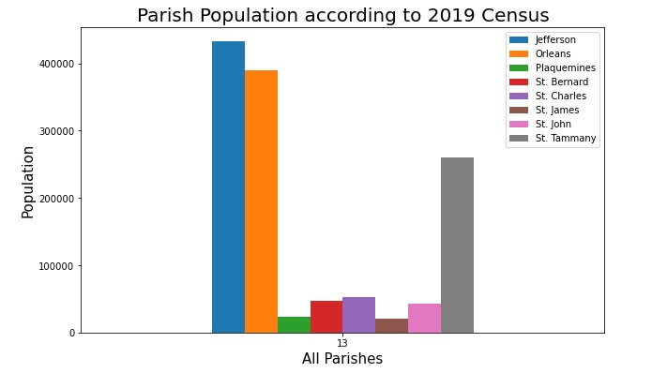
Highest population per parish
According to the chart, it is evident that in the New Orleans Metro Area, Jefferson and Orleans Parishes are the most populated. We choose Orleans Parish.

Slide 5
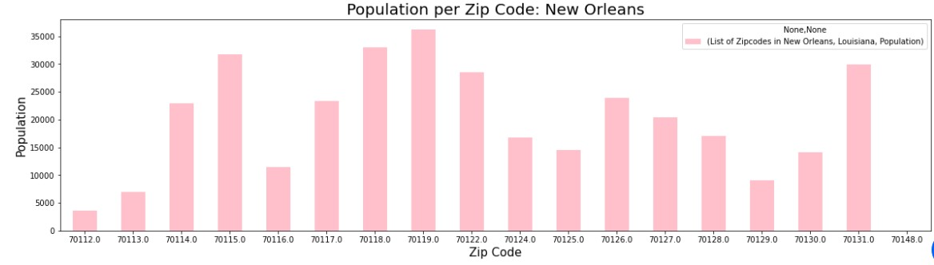
Population per zip code : Orleans Parish
According to our results, among the most populated zip codes are 70115, 70118, 70119, 70122 and 70131.

Slide 6
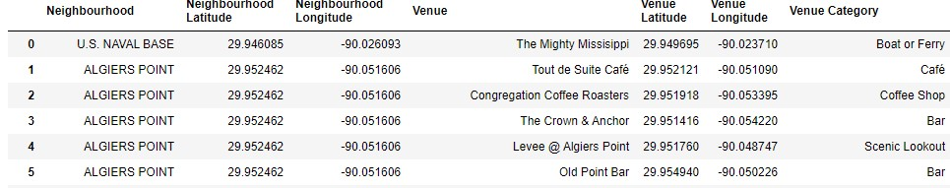
Using Foursquare API
After getting all venues of New Orleans, relevant information is retrieved like Venue Latitude, Venue Longitude and Venue Category.
We check how many venues are in each neighborhood.
Unique categories are retrieved for all the returned venues and the restaurant category is picked out as we only need information related to different restaurants in the area.

Slide 7
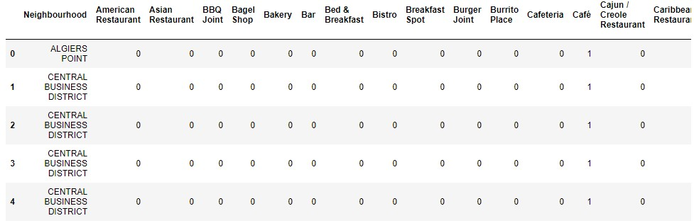
One hot encoding
All the restaurants are counted in each neighborhood.

Slide 8
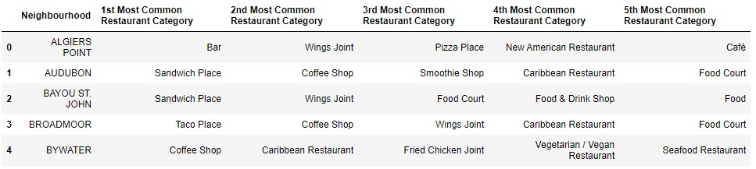
Using common category as a feature to group into clusters
The five most common restaurant categories are retrieved for each neighborhood. This feature will be used to group neighborhoods into clusters.

Slide 9
K Means Clustering
The “Elbow” Method is used to find the optimal k.
The sum of squares at each number of clusters is calculated and graphed.
The user looks for a change of slope from steep to shallow (an elbow) to determine the optimal number of clusters.
The clustering model is built and the values of the Distortion and Inertia are calculated.
Distortion: It is calculated as the average of the squared distances from the cluster centers of the respective clusters. Typically, the Euclidean distance metric is used.
Inertia: It is the sum of squared distances of samples to their closest cluster center.

Slide 10
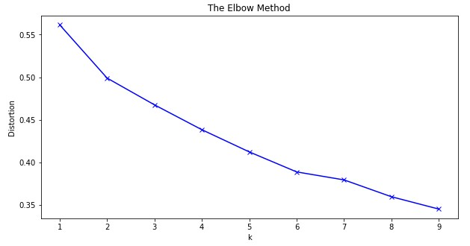
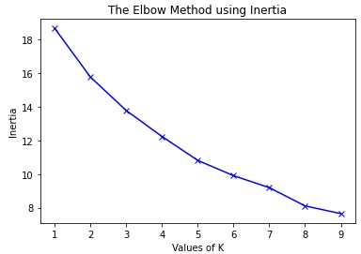
Distortion/Inertia graphs
We choose k to be 7.

Slide 11
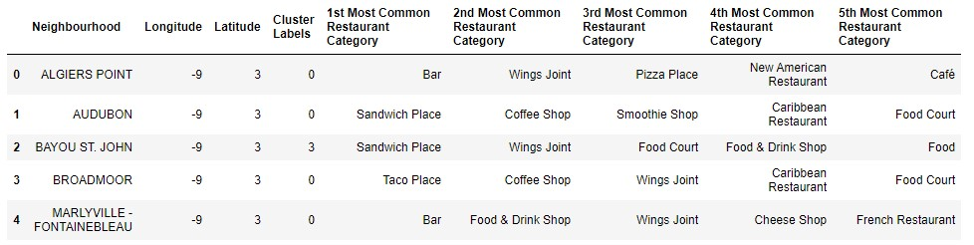
Data segmentation and label generation
Run K means and segment data into 7 clusters and generate labels.
Merge the NOLA data with neighborhood coordinates data
Add clustering labels
Create new data frame with both cluster labels and common venues
The centroid is calculated. It is the mean of the values of the points of data in the cluster. This is our ideal location to open a restaurant.

Slide 12
Opencage and Folium
Geocoding API - Opencage will be used to convert latitude and longitude values to addresses to see which neighborhood area is the best to open a restaurant.
Folium library will be used to visualize the neighborhoods in New Orleans and the resulting clusters.

Slide 13
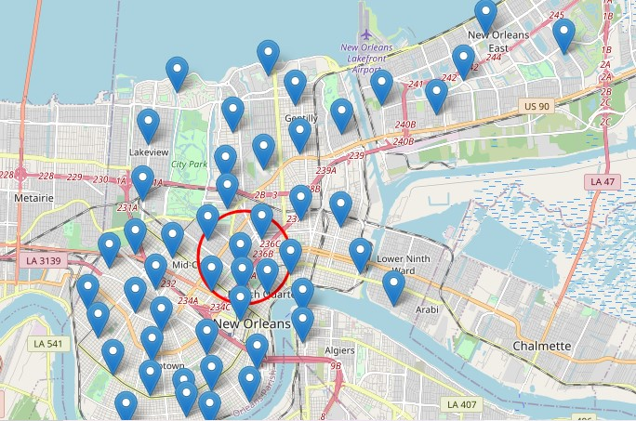
Results
The best neighborhood to open a restaurant in New Orleans is Treme/Lafitte and the address is 1228 North Johnson Street, New Orleans, LA 70116, United States of America

Slide 14
Conclusion
According to our results, Treme/Lafitte is the best neighborhood to open a traditional restaurant.
Treme/Lafitte is not highly populated, but it has a potential for successful emerging and booming startups as it is adjacent to some of the most accessible areas in New Orleans, like the French Quarter which is the heart of New Orleans.
Among the top venues in Treme/Lafitte are Southern / Soul Food Restaurants and Cajun/creole restaurants.
Future Recommendations:
Four square venue location accuracy can be improved to give better results.
The performance of kmeans is not fully accurate compared. If there are any changes in data, it could lead to more inaccuracy. Other clustering techniques can also be used.
It is possible that the Geocoding API can return inaccurate locations as many places have the same name. This can be improved by building larger databases and keeping the data up to date.

